Slide 1
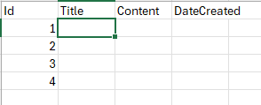

Must be unique identifier
namespace DiaryApp.Models
{
public class DiaryEntry
{
public int Id { get; set; }
public string Title { get; set; }
public string Content { get; set; }
public DateTime Created { get; set; }
}
}

Slide 2
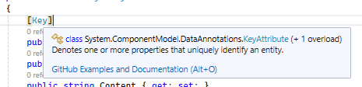
ANOTATIONS
using System.ComponentModel.DataAnnotations;
namespace DiaryApp.Models
{
public class DiaryEntry
{
[Key]
public int Id { get; set; }
[Required]
public string Title { get; set; } = string.Empty;
[Required]
public string Content { get; set; } = string.Empty;
[Required]
public DateTime Created { get; set; } = DateTime.Now;
}
}
Key annotation is not needed for Id (or DiaryEntryId). But it cannot be called different
Empty string is not null

Slide 3
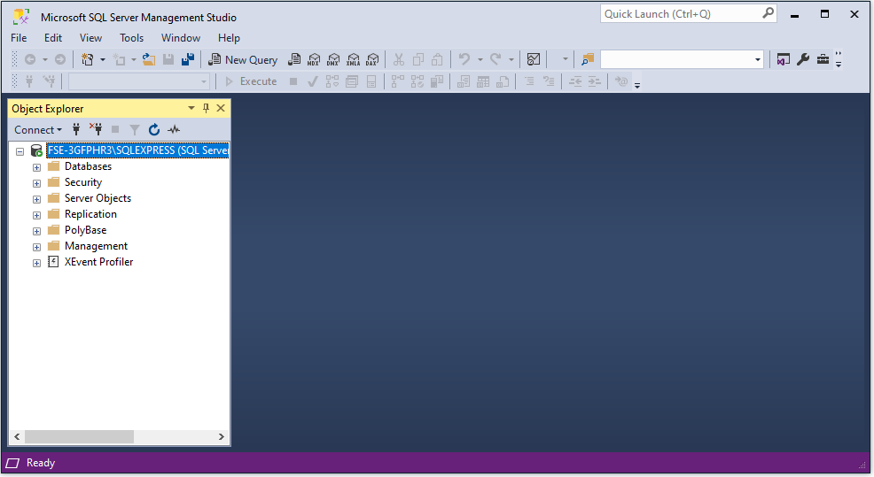
Setting up SQL Server and SQL Server management Studio
- Install SQL Server
- Insall SQL Server management Studio (SSMS)

Slide 4
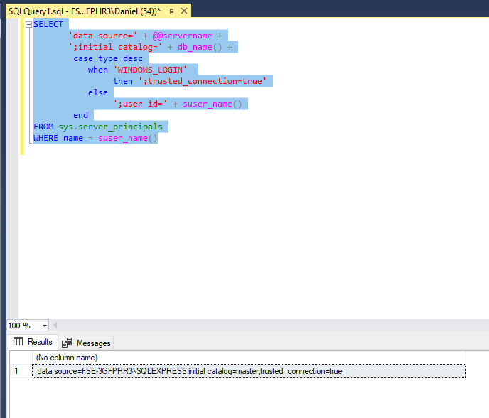
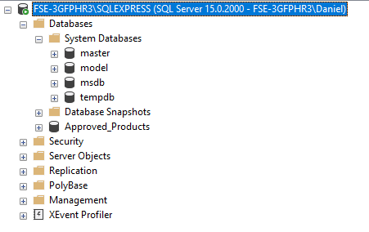
Connection String
SSMS

Slide 5
Connect to the Server in the App
In appsettings.json add the default connection
{
"Logging": {
"LogLevel": {
"Default": "Information",
"Microsoft.AspNetCore": "Warning"
}
},
"AllowedHosts": "*",
"ConnectionStrings": {
"DefaultConnection": "FSE-3GFPHR3\\SQLEXPRESS; Database = master; Trusted_Connection = True, TrustedServerCertificate=True"
}
}

Slide 6
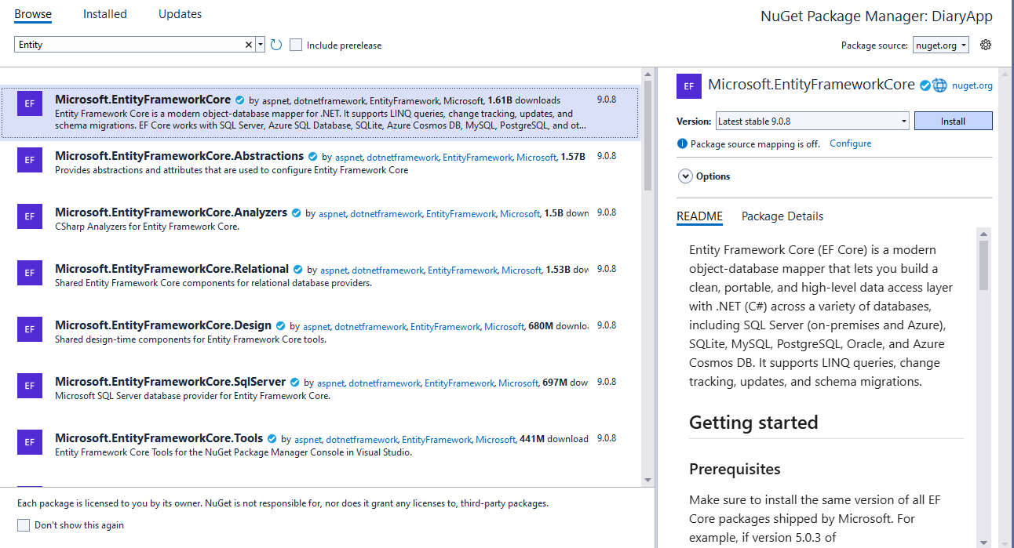
Install
Microsoft.Entity.FrameworkCore
Microsoft.Entity.FrameworkCore.SqlServer
Microsoft.Entity.FrameworkCore.Tools

Slide 7
<Project Sdk="Microsoft.NET.Sdk.Web">
<PropertyGroup>
<TargetFramework>net9.0</TargetFramework>
<Nullable>enable</Nullable>
<ImplicitUsings>enable</ImplicitUsings>
</PropertyGroup>
<ItemGroup>
<PackageReference Include="Microsoft.EntityFrameworkCore" Version="9.0.8" />
<PackageReference Include="Microsoft.EntityFrameworkCore.SqlServer" Version="9.0.8" />
<PackageReference Include="Microsoft.EntityFrameworkCore.Tools" Version="9.0.8">
<PrivateAssets>all</PrivateAssets>
<IncludeAssets>runtime; build; native; contentfiles; analyzers; buildtransitive</IncludeAssets>
</PackageReference>
</ItemGroup>
</Project>
In Project file are included all the newly added NuGets.

Slide 8
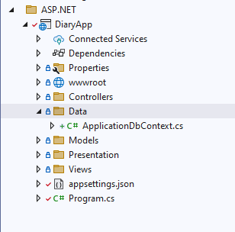
Create a new ApplicationDbContext.cs
Inherits from DbContext
using Microsoft.EntityFrameworkCore;
namespace DiaryApp.Data
{
public class ApplicationDbContext: DbContext
{
}
}

Slide 9
Setup a constructor
using Microsoft.EntityFrameworkCore;
namespace DiaryApp.Data
{
public class ApplicationDbContext: DbContext
{
public ApplicationDbContext(DbContextOptions<ApplicationDbContext> options): base(options)
{
}
}
}
Accepts the DbContextOptions of type ApplicationDbContext
This is passed to the base method (constructor)

Slide 10
Add a new Service.AddDbContext to the Program.cs
using DiaryApp.Data;
using Microsoft.EntityFrameworkCore;
var builder = WebApplication.CreateBuilder(args);
// Add services to the container.
builder.Services.AddControllersWithViews();
builder.Services.AddDbContext<ApplicationDbContext>(
options => options.UseSqlServer(builder.Configuration.GetConnectionString("DefaultConnection")));
var app = builder.Build();
// Configure the HTTP request pipeline.
if (!app.Environment.IsDevelopment())
{
app.UseExceptionHandler("/Home/Error");
// The default HSTS value is 30 days. You may want to change this for production scenarios, see https://aka.ms/aspnetcore-hsts.
app.UseHsts();
}
app.UseHttpsRedirection();
app.UseRouting();
app.UseAuthorization();
app.MapStaticAssets();
app.MapControllerRoute(
name: "default",
pattern: "{controller=Home}/{action=Index}/{id?}")
.WithStaticAssets();
app.Run();

Slide 11
Creating a Database and Table
In may be needed to add to the connection string: ;MultipleActiveResultSets=true
It can add performance issues, but it allows multiple instances to access all together.
Four steps to add a table:
Create a Model Class (done)
Add Db Set
Add-migration AddDiaryEntryTable
Update-database
using DiaryApp.Models;
using Microsoft.EntityFrameworkCore;
namespace DiaryApp.Data
{
public class ApplicationDbContext: DbContext
{
public ApplicationDbContext(DbContextOptions<ApplicationDbContext> options): base(options)
{
}
public DbSet<DiaryEntry> DiaryEntries { get; set; }
}

Slide 12
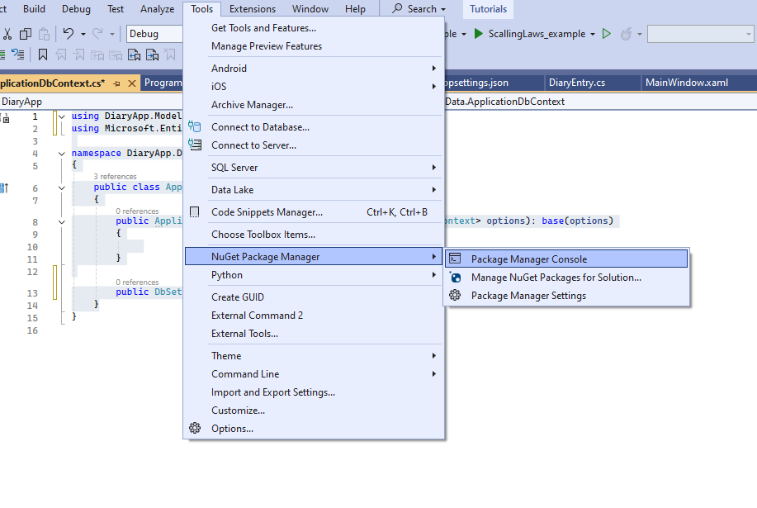
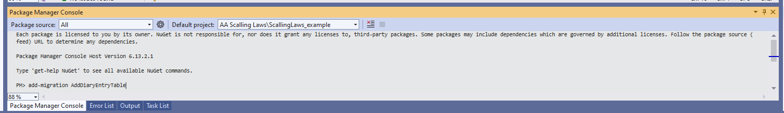
How to run Add Db Set?

